Slide 1
Automatic Indexing
Stemming methods
References:
  BR: Chapter 7
  FB92: Chapter 8
COMP 336 Dik Lun LEE Department of Computer Science, HKUST, Slide <number>

Slide 2
Text Representation
Text can be represented as
  a string
  words (statistical IR)
  linguistic units (e.g., nouns, phrases)
Simple representation (single terms, or individual words) performs surprisingly well
  many previous studies actually showed that phrase indexing perform poorer than word indexing
  phrases may be too specific (different phrases with same meaning)
COMP 336 Dik Lun LEE Department of Computer Science, HKUST, Slide <number>

Slide 3
Indexing Process
Identify words occurring in the documents
Remove stop words
Stem words using some stemming algorithm
Replace stems by index term numbers (for efficient manipulation)
Count occurrence of stems (tf)
(optional) use thesaurus for low frequency terms
(optional) form phrase for high frequency terms
Compute weight for all single terms, phrases and thesaurus classes (based on retrieval model)
Assign to each document the existing single terms, phrases, and thesaurus classes with corresponding weights
COMP 336 Dik Lun LEE Department of Computer Science, HKUST, Slide <number>

Slide 4
Indexing Process -- An Example
1. Input text
The analysis of 25 indexing algorithms has not produced consistent retrieval performance. The best indexing technique for retrieving documents is not known
2. Remove stop words
analysis indexing algorithms produced consistent retrieval performance best indexing technique retrieving documents known
3. Stemming
analysis index algorithm produc consistent retriev perform best index technique retriev document known
4. Replace with index numbers
  123 345 110 2234 432 3565 2302 566 345 4321 3565 755 1128
5. Compute tf
  110 1 123 1 345 2 1 432 1 566 1 755 1 1128 1 2302 1 2344 1 3565 2 4321 1
6. Term weighting (dependent on model used)
COMP 336 Dik Lun LEE Department of Computer Science, HKUST, Slide <number>

Slide 5
The Retrieval Process
remove stop words from query
stem words using the same algorithm used in indexing
replace stems by index term numbers
compute weight for all query terms
form the query vector (vector space model)
compute similarity between query and document vectors
return ranked list of documents
COMP 336 Dik Lun LEE Department of Computer Science, HKUST, Slide <number>

Slide 6
Match between Indexing and Search Processes
Indexing
Search
Stopword dictionary: the same has to be used on both sides; it is fine if search side is more restricted
Stemming algorithm: the same has to be used on both sides
Stemming
Stemming
yes
no
√
yes
no
？
？
√
Stopword
Stopword
yes
no
√
yes
no
？
？
√
COMP 336 Dik Lun LEE Department of Computer Science, HKUST, Slide <number>

Slide 7
Purpose of Stemming
Stemming algorithms reduce all words with the same root to a single form to overcome the variants of word forms
  RECOGNIZE, RECOGNISE, RECOGNIZED, RECOGNIZATION
Stemming has two advantages:
  reduce the number of distinct terms (i.e., smaller index size)
  identify words with similar meaning (to enhance recall)
Comments
  stemming is studied here to improve IR performance, not for linguistic analysis
  correctness is significantly less than 100%
  incorrect stemming might alter the meaning of a word
  (“French fries” -> “French fr”)
COMP 336 Dik Lun LEE Department of Computer Science, HKUST, Slide <number>

Slide 8
Common Stemming Methods
No stemming on text but expand query terms (ask the user to choose equivalent terms from a list or using predefined mapping table). E.g.,
  original query = computer
  expanded query = computer OR computation OR …
  in the text collection, all words are indexed without stemming
Most IR systems perform stemming on both text and query terms
  Right-hand truncation is most common (reduce suffixes but not prefixes)
  Need to avoid over and under truncation
    MEDICAL, MEDIA and MEDIUM being identified as MED*
Pros and cons? First method allows precise matching when needed but more time consuming
COMP 336 Dik Lun LEE Department of Computer Science, HKUST, Slide <number>

Slide 9
Stemming Methods
Automatic Stemming
Affix
removal
Successor
Variety
Table
Lookup
N-gram
Longest
Match
Simple
Removal
Context
Sensitive
COMP 336 Dik Lun LEE Department of Computer Science, HKUST, Slide <number>

Slide 10
Table Lookup
Construct a table of terms and their stems
The table can be indexed to speed up the search
The space overhead may be high
Difficult to construct the table
  to capture all possibilities (e.g., new words)
  handle context sensitivity (“fries” shouldn’t be stemmed in “French fries”)
TERM STEM
engineering engineer
engineered engineer
engineer engineer
COMP 336 Dik Lun LEE Department of Computer Science, HKUST, Slide <number>

Slide 11
Affix Removal Algorithms
Affix removal algorithms remove suffices and/or prefixes from terms to obtain a stem
Most of the algorithms use a suffix list to remove suffixes, the common word endings, such as -SES, -ATION, -ING, etc.
  Longest matching resulting in minimum stem length
    remove the longest matching suffix from a word first:
    computability → comput
  Iterative longest matching
    repeating the longest match :
      WILLINGNESS → remove NESS → remove ING → WILL
    singing → sing → s
  Avoid:
    ability → NULL, sing → s
Choose the longest:
ty → φ
ability → φ
ing → φ
COMP 336 Dik Lun LEE Department of Computer Science, HKUST, Slide <number>

Slide 12
Context Sensitive vs. Context Free
Context free -- remove the suffixes according to the suffix list (or set of rules)
Context sensitive -- consider the other characters in the word
  Compare context free rule ti → ty and the context sensitive rule Ati → Aty
  A stands for any string and is the context for the transformation ti → ty
  If a word ends in ti then change ti to ty
E.g., beautiful → beauti → beauty
  If Aki → Aky, we get: ski → sky
  It is wrong, adjust context A: any string containing a vowel
Many exception rules need to be handled:
  Removal of -ABLE from TABLE or -S from GAS
  Eliminating doubling of terminal consonants: FORGETTING and FORGET
COMP 336 Dik Lun LEE Department of Computer Science, HKUST, Slide <number>

Slide 13
Porter’s Algorithm (1980)
A compact algorithm with performance comparable to larger algorithms.
60 suffixes grouped into five steps
Each step has a set of context free and context sensitive rules to either remove the suffix or transform it into other forms.
  context free rules: sses → ss, ies → i, s → NULL
  context-sensitive rules. E.g.,
  (*v*) : ed → NULL, ing → NULL
  where (*v*) means the stem contains a vowel.
  plastered → plaster
  tied → ti
  bled → bled applying the rule results in a stem without vowel
  bed → bed
  motoring → motor
  sing → sing applying the rule results in a stem without vowel
Detailed rules are given in FB93, Chap 8
COMP 336 Dik Lun LEE Department of Computer Science, HKUST, Slide <number>

Slide 14
Problem with Affix Removal Algorithms
Porter’s algorithm requires a lot of linguistic knowledge to define the rules
May not be able to cover all cases/possibilities because of the complexity of human language
Language dependent
COMP 336 Dik Lun LEE Department of Computer Science, HKUST, Slide <number>

Slide 15
Successor Variety Stemming
Based on statistical analysis of a collection of documents (I.e., corpus)
  given a large enough corpus, a list of probably stems can be obtained by statistical analysis of the corpus
Automatic and less dependent on the language used
Given a word, there are many varieties derived from the word, but people tend to retain the spelling of the original word:
2
People tend to create lots of variants around a (almost) fixed string (a platform or foundation to build words).
“problem” in this example is clear; “probab” and “probabl” are possible stems.
1
problem
problems
problematic
probability
probably
probable
People tend not to make significant spelling changes on the stems
The problem is to find a string that has a large number of variants derived from it.
COMP 336 Dik Lun LEE Department of Computer Science, HKUST, Slide <number>

Slide 16
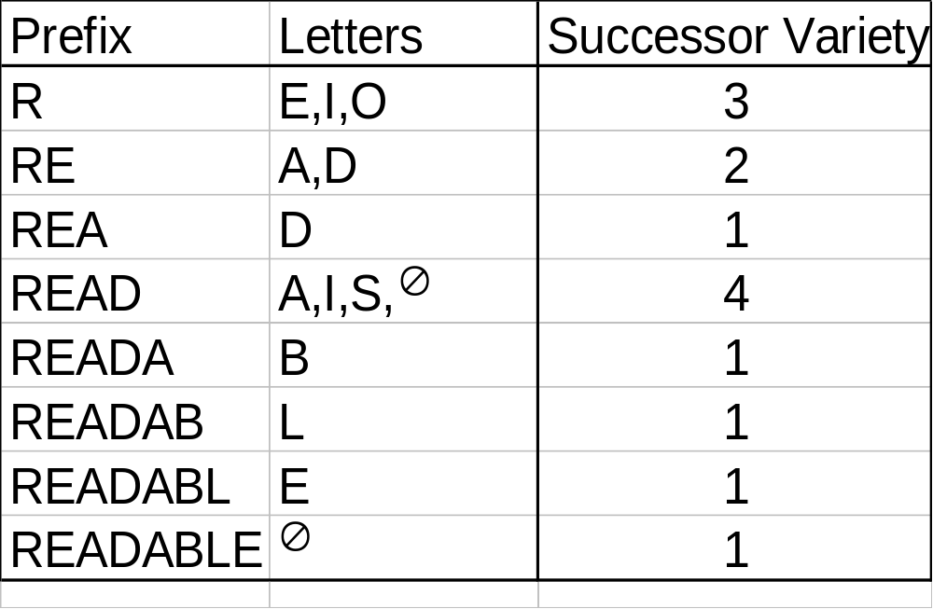
Definition and Example
The successor variety for a string is defined as:
  the number of different characters that follow the string in a corpus
Corpus
ABLE∅
APE∅ BEATABLE∅
FIXABLE∅ READ∅ READABLE∅
READING∅ READS∅
RED∅
ROPE∅
RIPE∅
COMP 336 Dik Lun LEE Department of Computer Science, HKUST, Slide <number>

Slide 17
Example
Consider the English dictionary (a corpus of all legal English words)
  pr? -> what is the successor varieties?
  pro? -> ?
  Is pr or pro likely to be a stem (pr or pro carries some meaning)?
  Conclusion/Heuristic: if a prefix has a low successor variety, then the chance for the prefix to be a meaningful stem (or a legal word) is very low.
  Consider jum?, few legal words exist: jump, jumble, jumbo
Ans: 6 pr[aeiouy]
Ans: 17 (all consonants except q, y, z)
COMP 336 Dik Lun LEE Department of Computer Science, HKUST, Slide <number>

Slide 18
Segment a Word
Segment the word using one of the following
  cut off method
    boundary is determined by the cutoff value of successor variety
    segment when successor variety >= threshold
    consider threshold = 2 R|E|AD|ABLE
  peak and plateau method
    break at the character whose success variety is greater than both its preceding and following character READ|ABLE
  entropy method
COMP 336 Dik Lun LEE Department of Computer Science, HKUST, Slide <number>

Slide 19
Select Stem
Select one of the segments as the stem, e.g.,
  readable -> read, a, ble
  choose “read” as the stem
Stem is selected based on heuristics:
  either the first or second segments will be selected as the stem
  if the first one is more likely a prefix (e.g., based on a dictionary of prefixes or by counting frequencies), select the second segment as the stem; otherwise, the first one is selected
Complete word method
  Prefer a stem that is a complete word in the corpus (READ)
COMP 336 Dik Lun LEE Department of Computer Science, HKUST, Slide <number>

Slide 20
Entropy Method in Stemming (1)
Absolute successor variety (sv) values are not reliable because it counts the number different characters following a given prefix but not how many times they occur.
sv(probab)=2
probability
probably
probable
probable
probability
probably
probable
probable
sv(probabl)=2
Even both segments have sv=2, “probab” is less varied because “l” appears twice.
Predicting “l” has 2/3 the chance to be correct, whereas predicting either “y” (or “e”) in the second case has ½ chance to be correct.
COMP 336 Dik Lun LEE Department of Computer Science, HKUST, Slide <number>

Slide 21
Entropy Method in Stemming (2)
How to take occurrence probability of a letter into consideration?
  Pioneered by Shannon, entropy was used in information theory to measure the difficulty of predicting the next event in a serious of events.
  The larger the entropy, the harder it is to predict the next event.
Given a discrete random variable X with n possible outcomes
{x₁, ..., x_{n}}, the entropy H(X) = - Σ^{n}_{i =1} p(x_{i}) log_{b} p(x_{i}),
p(xi) is the probability of outcome x_{i}.
When b=2, the unit of H(X) is bit.
A single toss of a fair coin has an entropy of one bit. Two tosses has entropy of two bits, etc. If the coin always turns out heads (or tails), then entropy is zero.
From Shannon’s experiment, the entropy of English text is between 1.0 and 1.5 bits (or as low as 0.6 to 1.3 bits) per letter.
COMP 336 Dik Lun LEE Department of Computer Science, HKUST, Slide <number>

Slide 22
Entropy Method in Stemming (3)
Entropy of a letter sequence α is defined as:
  Probability that char “j” follows α =
  number of strings with prefix αj (denoted as |D_{αj}|) /
  number of strings with prefix α (denoted as |D_{α}|)
    P_{α j} = |D_{α j}|/ |D_{α}|
  Entropy sums up the probabilities for all characters that follow α
  |H_{α}| = Σ _{j=‘a’→‘z’} − P_{α j} log₂ P_{α j}
for α = RE, |D_{α}| = 5
for j = ‘A’, |D_{α j}| = 4
for j = ‘D’, |D_{α j}| = 1
H_{α} = - 1/5 * log₂ (1/5) - 4/5 * log₂ (4/5)
= 0.46 + 0.26 = 0.72
This value is low because “REA…” appeared four times!
Use cutoff or peak-and-plateau methods on the entropy values to determine the boundary
ABLE
APE BEATABLE
FIXABLE
READ READABLE
READING READS
RED
ROPE
RIPE
D_{α}
D_{α j|j =‘A’}
D_{α j|j =‘D’}
COMP 336 Dik Lun LEE Department of Computer Science, HKUST, Slide <number>

Slide 23
Previous Example
H_{α} (α = probab) = - (0.33*log₂ 0.33 + 0.67*log₂ 0.67) = 0.53 + 0.38 = 0.91
H_{α} (α = probabl) = - (0.5*log₂ 0.5 + 0.5*log₂ 0.5) = 1
probability
probably
probable
COMP 336 Dik Lun LEE Department of Computer Science, HKUST, Slide <number>

Slide 24
What is the purpose of obtaining the stem of a word?
COMP 336 Dik Lun LEE Department of Computer Science, HKUST, Slide <number>

Slide 25
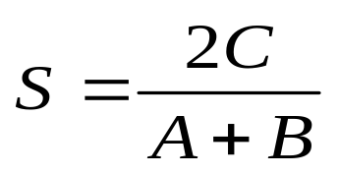
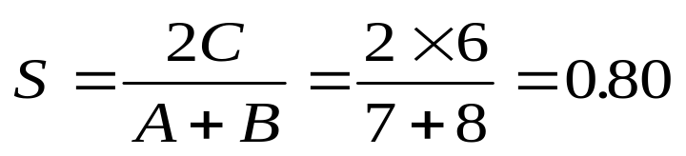
Shared Bigram Stemming
Terms are represented using n-grams
  statistics ==> st ta at ti is st ti ic cs
  statistical ==> st ta at ti is st ti ic ca al
Similarity of two terms are measured by Dice’s coefficient
where A and B are the number of unique bigrams in two terms, respectively, and C is the number of unique bigrams shared by the two terms.
Terms form clusters and terms in the same cluster can share the same stem: {statistics, statistical, statistically, …}
Tri-grams (3-character sequences) can be used
COMP 336 Dik Lun LEE Department of Computer Science, HKUST, Slide <number>

Slide 26
A Typical Term Selection Process
Data for 1,033 documents in medicine
Identify all unique words
delete 170 common function words included in stop list
delete terms with document frequency equal to 1 (likely to be a typo or a word that no one is interested in)
remove terminal ‘s’ endings and combine identical word forms
delete 30 very high frequency terms occurring in over 25% of the documents
delete 255 additional terms with negative discrimination values (related to high DF)
13,471 terms
13,301 terms left
7,236 terms left
6,056 terms left
6,026 terms left
5,771 terms left
Reduced to 43% of original number of words
COMP 336 Dik Lun LEE Department of Computer Science, HKUST, Slide <number>

